Slide 1

NGS Class Exercises

Slide 2
Quality Control (QC)

Slide 3
QC Evaluation
Use FastQC to visualize quality scores
Displays quality score distribution of a subset of ~200,000 reads
Input is a fastq file or files
Can disable grouping (binning) of sequence regions
Will alert you of poor read characteristics
Can be run as a GUI or a command line interface
module load FastQC/0.11.5-Java-1.7.0_80
FastQC will process using one CPU core per file
If there are 10 fastq files to analyze and 4 cores used
4 files will start processing and 6 will wait in a queue
If there is only one fastq file to process then using 10 cores does not speed up the process

Slide 4
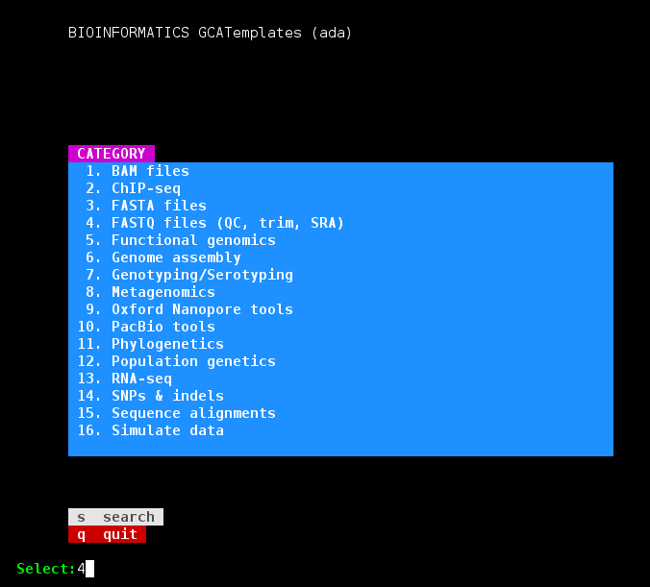
Finding NGS job template scripts using GCATemplates on Ada
Genomic Computational Analysis Templates
mkdir $SCRATCH/ngs_class
cd $SCRATCH/ngs_class
module load GCATemplates
gcatemplates
For practice, we will copy a template file
Select #4 then find the template that contains fastqc
Final step will save a template job script file to your current working directory

Slide 5
FastQC Exercise
Use the GCATemplate for FastQC to submit a job evaluating the two provided sequence files
After your fastqc job is complete, unzip the results file and you can view the results files with lynx and eog (eog requires X11 login)
emacs run_fastqc_0.11.5_ada.sh &
bsub < run_fastqc_0.11.5_ada.sh
unzip DR34_R1_fastqc.zip

Slide 6
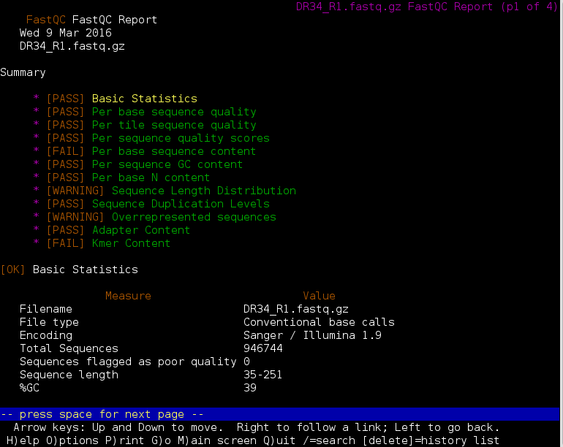
FastQC Report using lynx
lynx DR34_R1_fastqc.html

Slide 7
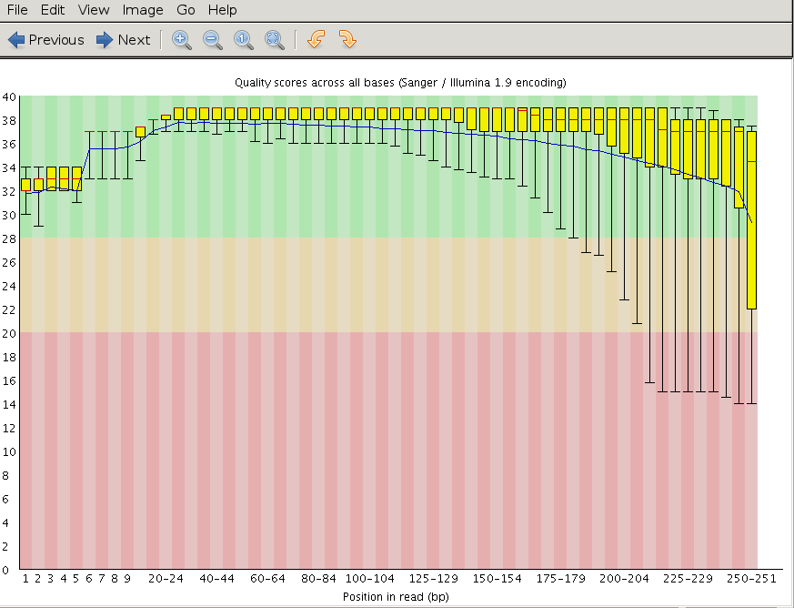
FastQC Output Image Quality Distribution
eog DR34_R1_fastqc/Images/per_base_quality.png
click for the next image in the same directory,
or use the left/right arrow keys
Prior to QC trimming

Slide 8
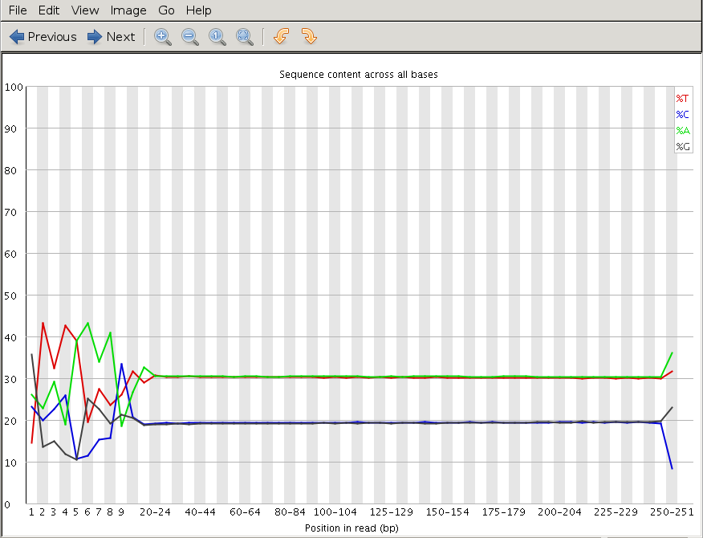
Illumina Transposon Insertion Site
per_base_sequence_content.png

Slide 9
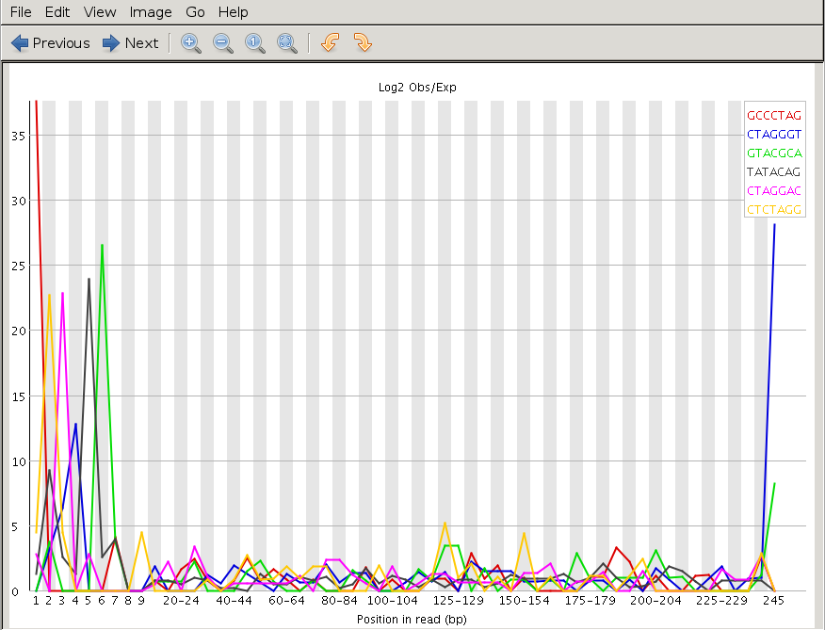
Illumina Transposon Insertion Site
kmer_profiles.png

Slide 10
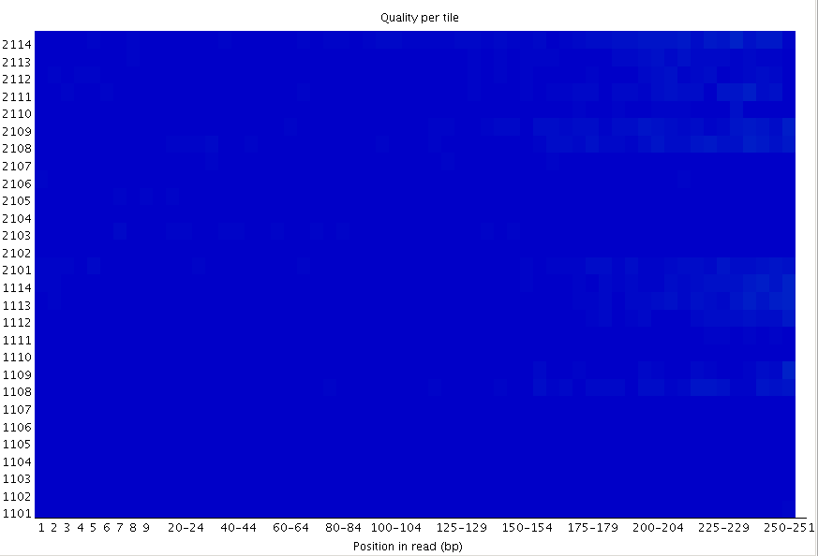
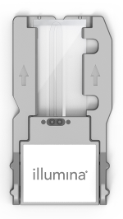

FastQC Flowcell Quality Image
per_tile_quality.png
Flowcell quality mapping
Good per_tile quality
MiSeq flowcell
good quality poor quality

Slide 11
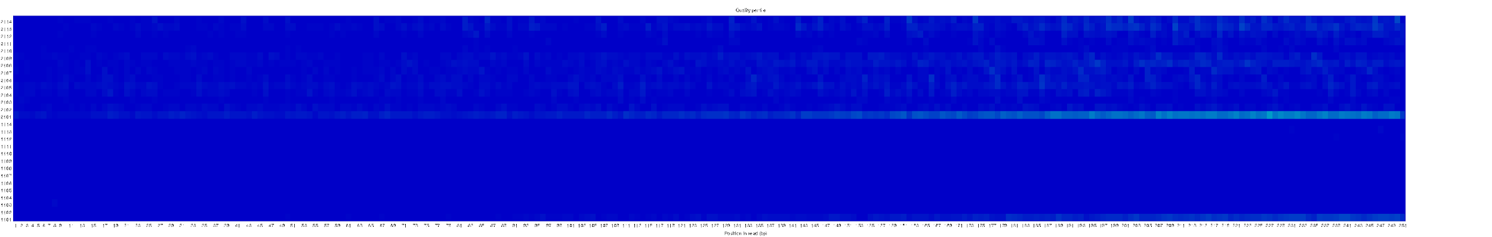
FastQC Flowcell Quality Image
per_tile_quality.png
bottom of
flowcell
MiSeq flowcell
top of
flowcell
good quality poor quality

Slide 12
QC Quality Trimming
Sequence quality trimming tools
Trimmomatic will maintain paired end read pairing after trimming
Trim reads based on quality scores
Trim the same number of bases from each read or
Use a sliding window to calculate average quality at ends of sequences
Decide if you want to discard reads with Ns
some assemblers replace Ns with As or a random base G, C, A or T
Trim adapter sequences
Trimmomatic has a file of Illumina adapter sequences
module spider Trimmomatic
recommended tool
module load Trimmomatic/0.36-Java-1.8.0_92
ls $EBROOTTRIMMOMATIC/adapters/

Slide 13
Trimmomatic Exercise using GCATemplates on Ada
Genomic Computational Analysis Templates
gcatemplates
For practice, we will copy a template file
Select #4 then find the template that contains trimmomatic
Save the template script to your pwd
Review the template script contents
Submit the template script to the scheduler
Review the output files

Slide 14
Sequence Mapping and Visualization

Slide 15
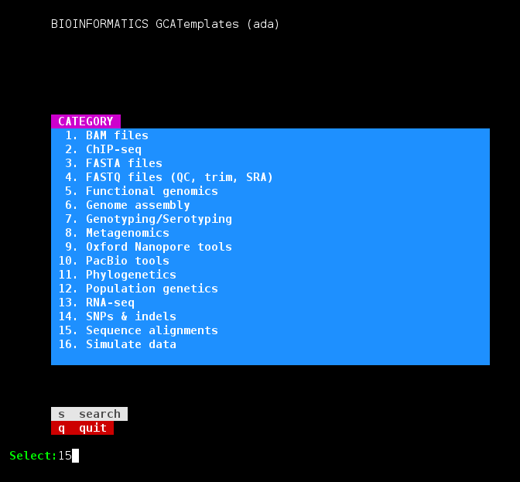
DNA Sequence Alignment Exercise GCATemplates on Ada
Genomic Computational Analysis Templates
gcatemplates
For practice, we will copy a template file
Select
#15 Sequence alignments
align genomic to reference
bwa_0.7.17 samtools_1.7
pe library
Save the template script to your pwd
Review the template script contents
Submit the template script to the scheduler
Review the output files

Slide 16
Viewing sam/bam Files with samtools
module load SAMtools/1.7-GCCcore-6.3.0
load the SAMtools module
samtools view DR34.bam | more
view only alignments
samtools view -H DR34.bam
view only header
samtools view -h DR34.bam | more
view header + alignments

Slide 17
Alignment Statistics
samtools flagstat DR34.bam
1898909 + 0 in total (QC-passed reads + QC-failed reads)
5421 + 0 secondary
0 + 0 supplementary
0 + 0 duplicates
1864922 + 0 mapped (98.21% : N/A)
1893488 + 0 paired in sequencing
946744 + 0 read1
946744 + 0 read2
1853282 + 0 properly paired (97.88% : N/A)
1857698 + 0 with itself and mate mapped
1803 + 0 singletons (0.10% : N/A)
2430 + 0 with mate mapped to a different chr
1386 + 0 with mate mapped to a different chr (mapQ>=5)
Both reads in the pair are mapped
on the same chromosome
and in FR or RF orientation

Slide 18
Sam Flags and Bits
Flags describe alignments (the flag value is the sum of bits)
read id
flag
chromosome
genome coordinate
sam format
B06PYABXX110322:2:2202:15484:157177 99 1 10016 0 86M15S = 10063 110
CCCTAACCCTAACCCTAACCACCCTAACCCTAACCCTAACCCTAACCCTAACCCTAACCCTAACCCTA
CDEGEHGHHIFIHIIJFIIIIJGJIIIIGJIIIJGJIJIJGHIJGKFHIJGKGIIHBIGIGHHHE@DF
57 XC:i:86 MD:Z:86 RG:Z:B06PY.2 AM:i:0 NM:i:0 SM:i:0 BQ:Z:BB MQ:i:0 XT:A:R
Filter bam alignments based on bit in flag (-f and/or -F)
Keep only reads that are 'mapped in proper pair'
Keep all except reads that are 'PCR or optical duplicate'
bits:
1 2 4 8 16 32 64 128 256 512 1024 2048
1 + 2 + 32 + 64 = 99
samtools view -h -b -f 2 DR34.bam > DR34_paired_reads.bam
samtools view -h -b -F 1024 DR34.bam > DR34_dedup_reads.bam

Slide 19
Create a bam index file
Create an index of the bam file using samtools
A samtools index is needed prior to viewing bam files in browsers
samtools index DR34.bam
DR34.bam.bai
This index file is created

Slide 20
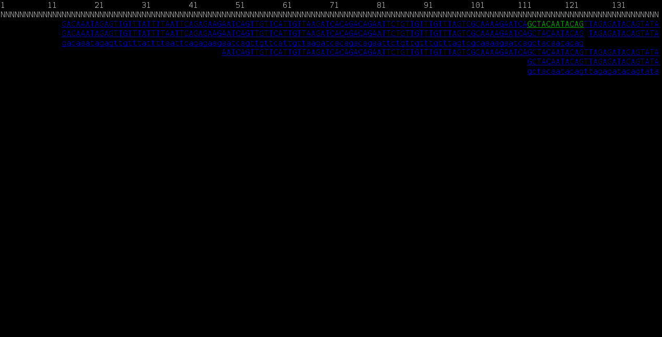
SAMtools without a Reference Genome
Reference genome represented on top as NNNNNNNNN
samtools tview DR34.bam

Slide 21
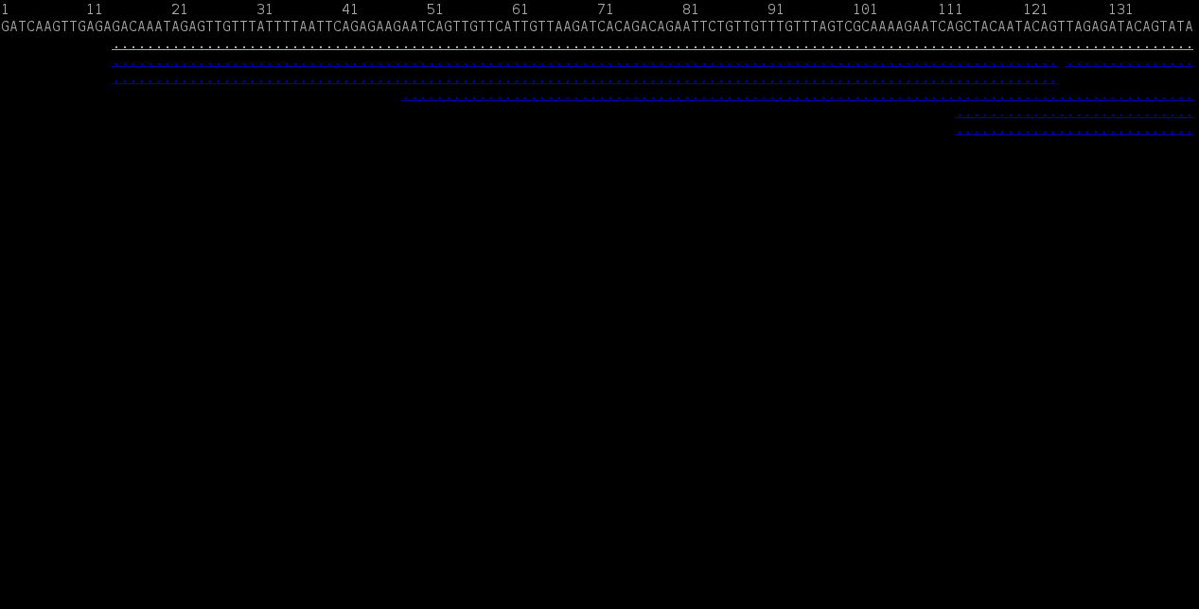
SAMtools with a Reference Genome
Reference genome sequence displayed on top
samtools tview DR34.bam C_dubliniensis_CD36.fasta

Slide 22
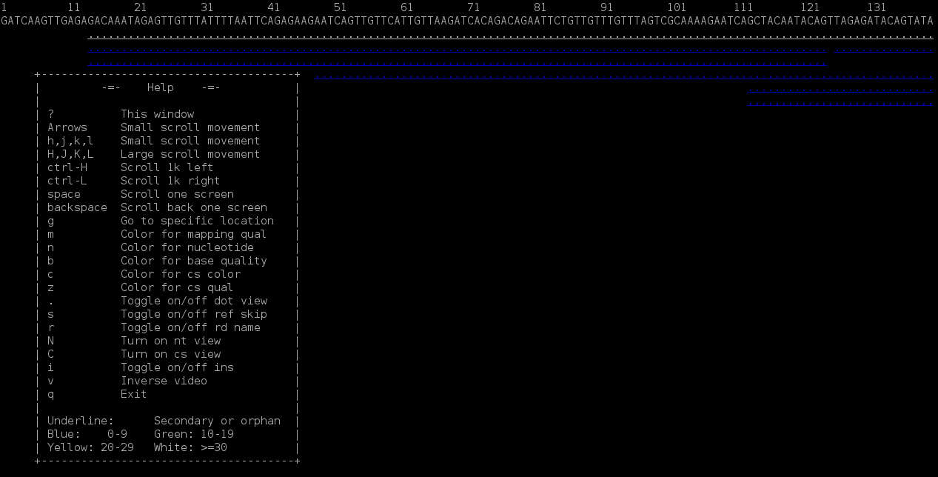
SAMtools with a Reference Genome
^{Type ? for help menu}
samtools tview DR34.bam C_dubliniensis_CD36.fasta

Slide 23
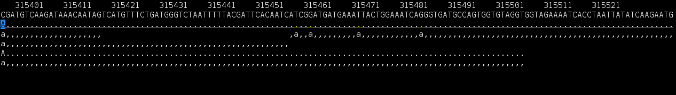
View at a Specific Coordinate
samtools tview DR34.bam C_dubliniensis_CD36.fasta -p Chr1_C_dubliniensis_CD36:315398

Slide 24
RNA-seq Alignment Exercise
Make a copy of your run_bwa_mem_samtools_pe_ada.sh script to run the RNA-seq alignment exercise
Edit your new file inputs variables and bwa command to use the following single end RNA-seq file
/scratch/datasets/GCATemplates/data/miseq/c_dubliniensis/c.dubl_rnaseq.fastq

Slide 25
Analyzing hundreds
or thousands of files

Slide 26
Multi-File Processing
If you have 100’s or 1,000’s of files to process with a tool that can only utilize one compute node, it could take days or weeks to process if you run one at a time.
spades.py --careful --memory 5 --threads 2 -o EC00144241_S85_build -1 EC00144241_S85_L001_R1_001.fastq.gz -2 EC00144241_S85_L001_R2_001.fastq.gz --tmp-dir $TMPDIR
spades.py --careful --memory 5 --threads 2 -o EC00502067_S15_build -1 EC00502067_S15_L001_R1_001.fastq.gz -2 EC00502067_S15_L001_R2_001.fastq.gz --tmp-dir $TMPDIR
spades.py --careful --memory 5 --threads 2 -o EC01236313_S68_build -1 EC01236313_S68_L001_R1_001.fastq.gz -2 EC01236313_S68_L001_R2_001.fastq.gz --tmp-dir $TMPDIR
spades.py --careful --memory 5 --threads 2 -o EC02035016_S50_build -1 EC02035016_S50_L001_R1_001.fastq.gz -2 EC02035016_S50_L001_R2_001.fastq.gz --tmp-dir $TMPDIR
spades.py --careful --memory 5 --threads 2 -o EC03218300_S17_build -1 EC03218300_S17_L001_R1_001.fastq.gz -2 EC03218300_S17_L001_R2_001.fastq.gz --tmp-dir $TMPDIR
spades.py --careful --memory 5 --threads 2 -o EC04615405_S96_build -1 EC04615405_S96_L001_R1_001.fastq.gz -2 EC04615405_S96_L001_R2_001.fastq.gz --tmp-dir $TMPDIR
spades.py --careful --memory 5 --threads 2 -o EC04856216_S88_build -1 EC04856216_S88_L001_R1_001.fastq.gz -2 EC04856216_S88_L001_R2_001.fastq.gz --tmp-dir $TMPDIR
spades.py --careful --memory 5 --threads 2 -o EC05148227_S53_build -1 EC05148227_S53_L001_R1_001.fastq.gz -2 EC05148227_S53_L001_R2_001.fastq.gz --tmp-dir $TMPDIR
spades.py --careful --memory 5 --threads 2 -o EC07674140_S20_build -1 EC07674140_S20_L001_R1_001.fastq.gz -2 EC07674140_S20_L001_R2_001.fastq.gz --tmp-dir $TMPDIR
spades.py --careful --memory 5 --threads 2 -o EC08067108_S58_build -1 EC08067108_S58_L001_R1_001.fastq.gz -2 EC08067108_S58_L001_R2_001.fastq.gz --tmp-dir $TMPDIR
spades.py --careful --memory 5 --threads 2 -o EC08328770_S90_build -1 EC08328770_S90_L001_R1_001.fastq.gz -2 EC08328770_S90_L001_R2_001.fastq.gz --tmp-dir $TMPDIR
spades.py --careful --memory 5 --threads 2 -o EC08834643_S65_build -1 EC08834643_S65_L001_R1_001.fastq.gz -2 EC08834643_S65_L001_R2_001.fastq.gz --tmp-dir $TMPDIR
spades.py --careful --memory 5 --threads 2 -o EC10485101_S57_build -1 EC10485101_S57_L001_R1_001.fastq.gz -2 EC10485101_S57_L001_R2_001.fastq.gz --tmp-dir $TMPDIR
spades.py --careful --memory 5 --threads 2 -o EC12123883_S45_build -1 EC12123883_S45_L001_R1_001.fastq.gz -2 EC12123883_S45_L001_R2_001.fastq.gz --tmp-dir $TMPDIR
spades.py --careful --memory 5 --threads 2 -o EC12334723_S72_build -1 EC12334723_S72_L001_R1_001.fastq.gz -2 EC12334723_S72_L001_R2_001.fastq.gz --tmp-dir $TMPDIR
spades.py --careful --memory 5 --threads 2 -o EC12344385_S95_build -1 EC12344385_S95_L001_R1_001.fastq.gz -2 EC12344385_S95_L001_R2_001.fastq.gz --tmp-dir $TMPDIR
spades.py --careful --memory 5 --threads 2 -o EC12600538_S14_build -1 EC12600538_S14_L001_R1_001.fastq.gz -2 EC12600538_S14_L001_R2_001.fastq.gz --tmp-dir $TMPDIR
spades.py --careful --memory 5 --threads 2 -o EC13365408_S44_build -1 EC13365408_S44_L001_R1_001.fastq.gz -2 EC13365408_S44_L001_R2_001.fastq.gz --tmp-dir $TMPDIR
spades.py --careful --memory 5 --threads 2 -o EC13880885_S84_build -1 EC13880885_S84_L001_R1_001.fastq.gz -2 EC13880885_S84_L001_R2_001.fastq.gz --tmp-dir $TMPDIR
spades.py --careful --memory 5 --threads 2 -o EC14371787_S81_build -1 EC14371787_S81_L001_R1_001.fastq.gz -2 EC14371787_S81_L001_R2_001.fastq.gz --tmp-dir $TMPDIR
spades.py --careful --memory 5 --threads 2 -o EC14418800_S13_build -1 EC14418800_S13_L001_R1_001.fastq.gz -2 EC14418800_S13_L001_R2_001.fastq.gz --tmp-dir $TMPDIR
spades.py --careful --memory 5 --threads 2 -o EC15011885_S10_build -1 EC15011885_S10_L001_R1_001.fastq.gz -2 EC15011885_S10_L001_R2_001.fastq.gz --tmp-dir $TMPDIR
spades.py --careful --memory 5 --threads 2 -o EC15712676_S34_build -1 EC15712676_S34_L001_R1_001.fastq.gz -2 EC15712676_S34_L001_R2_001.fastq.gz --tmp-dir $TMPDIR

Slide 27
Multi-File Processing
The first step is to get an idea of the resource usage to process one sample.
Run one sample (preferable with the largest input file) to get estimated Walltime, max memory, number of cores
Utilize one entire node to get an accurate assessment
Make sure you are not almost at your file or disk quota
-
Use $TMPDIR for temporary files whenever possible
For a tool that allows one or two-core processing on one node
Use TAMULauncher
For a tool that allows multi-core utilization of the entire compute node
Use a job array
showquota

Slide 28
Example Dataset
As an example, we will create a commands file for spades assemblies
100 samples (E. coli)
Pair-1 and pair-2 sequence files for each sample (200 files total)
Small bacterial genomes that only need about 2 GB of memory
Will use 2 cores per command which equals 5GB of memory (Ada)
Can run 10 assemblies per node; total of 50GB memory usage
1 core = 2.5 GB of memory for 1 hour charged as 1 SU
10 commands per node = 50GB of total requested memory
spades.py --careful --memory 5 --threads 2 -o EC00144241_S85_build -1 EC00144241_S85_L001_R1_001.fastq.gz -2 EC00144241_S85_L001_R2_001.fastq.gz --tmp-dir $TMPDIR
Sequence files are located in directory
/scratch/training/intro_to_ngs/reads/

Slide 29
Preparing A Commands File
Use UNIX shell commands to loop through your files and generate a command for each file or file set.
We want to capture the unique sample name such as: EC23875571_S8
List files using a mix of wildcards and characters so that you only capture read pair 1 file names
All pair-1 files end with _L001_R1_001.fastq.gz
ls /scratch/training/intro_to_ngs/reads/EC*_L001_R1*fastq.gz

Slide 30
Preparing A Commands File cont.
Use the command from the previous slide to create a list of files to loop through
Use shell variable substrings to capture the sample name from the filename
/scratch/training/intro_to_ngs/reads/EC85687002_S5_L001_R1_001.fastq.gz
for file in $(ls /scratch/training/intro_to_ngs/reads/EC*_L001_R1*fastq.gz)
do
name=${file##*/}
echo ${name%_L001*}
done
${var#*SubStr} # will drop beginning of string up to first occurrence of 'SubStr' ${var##*SubStr} # will drop beginning of string up to last occurrence of 'SubStr' ${var%SubStr*} # will drop part of string from last occurrence of 'SubStr' to the end ${var%%SubStr*} # will drop part of string from first occurrence of 'SubStr' to the end

Slide 31
Preparing A Commands File cont.
Save the output to a commands file appending each line using >>
data=/scratch/training/intro_to_ngs/reads
for file in $(ls $data/EC*_L001_R1*fastq.gz)
do
name=${file##*/}
echo spades.py --careful --memory 5 --threads 2 -o builds/${name%_L001*} \
-1 $data/${name%_L001*}_L001_R1_001.fastq.gz \
-2 $data/${name%_L001*}_L001_R2_001.fastq.gz --tmp-dir \$TMPDIR >> commands.txt
done
Spades will automatically create the builds/ directory
Use the backslash in front of $TMPDIR so echo will print the dollar sign
If your commands.txt file is incorrect, you need to delete it before creating it again

Slide 32
TAMULauncher Job Script
To run 50 assemblies concurrently; 10 per node on 5 nodes:
#BSUB -L /bin/bash # use bash for environment
#BSUB -J tamulaunch_spades # job name
#BSUB -n 100 # assigns 100 total cores for execution
#BSUB -R "span[ptile=20]" # assigns 20 cores per node
#BSUB -R "rusage[mem=2700]" # reserves 2700MB memory per core
#BSUB -M 2700 # sets to 2700MB per process enforceable memory
#BSUB -W 48:00 # sets to 48 hour the job's runtime wall-clock limit
#BSUB -o stdout.%J # directs the job's standard output to stdout.jobid
#BSUB -e stderr.%J # directs the job's standard error to stderr.jobid
module load SPAdes/3.11.1-GCCcore-6.3.0
# run 10 commands per node since each command uses 2 threads and Ada = 20 cores/node
tamulauncher --commands-pernode 10 commands.txt
This job takes about 2hr 30min with a final charge of about 255 SUs

